Slide 1
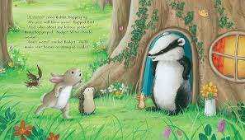

Creative curriculum – Bader and the Great storm
Week of 8th September: Super start! Settling in!
Mini Bears adventures with the children
Fantastic Finale! Adventure week!
Personal, social & emotional
-Creating a photo memory book
-Work co-operatively in small and large groups
-Discuss feelings and emotions by identifying how we feel using emojis
-sharing photos from home with the bear’s adventures
-creating stories using puppets
Communication, Language & Literacy
-Learning names
-Role play and drama
-Looking at fiction and non-fiction books
-Enjoying stories throughout the learning environment
-Exploring & recognising different sounds, copying beats.
Physical development
-Throwing and catching
- Moving in a variety of different ways
-Using different tools to construct with a purpose, - developing fine motor skills using hammers and golf tees, tweezers
Expressive arts and design
-Exploring paint through colour mixing hand-prints, printing animal prints and free painting etc
– Acting out stories and creating our own
Creating Holistic art using natural resources
Understanding the world
-Exploring the weather
-Sharing photos of “adventures with the mini Bears” from home
Visit from the Hedgehog man
Discussing migration and hibernation
Gardening – planting spring bulbs and a visit to the Green Grocers
Mathematics
-Exploring shapes with the magnetic blocks
-Discussing time and looking at the clock during pre school routines
-Recognising numerals as part of routines
- Numeral recognition with hedgehogs

